Slide 1
Deep Learning
Artificial Neural Nets
Short introduction into the world of neural networks.
Aleksandr Tavgen. Software Architect Playtech.

Slide 2
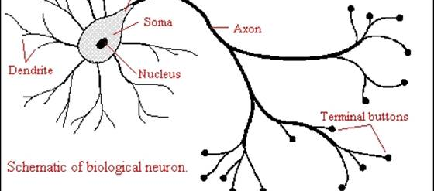
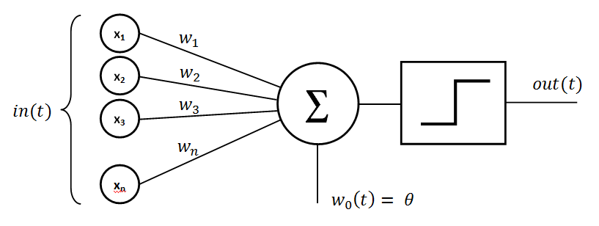

Biological Neuron
Perceptron
Perceptron is an algorithm for classification, but it could be seen as an abstract model of neuron, inspired by real neuron.
It can separate data finding the line, plane, hyperplane, that minimizes amount of classification errors.
First use case - Perceptron was designed for image recognition: it had an array of 400 photocells, randomly connected to the "neurons". US Navy wanted to detect military objects on the fotos.
FAILED

Slide 3
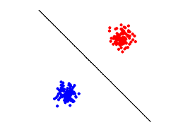
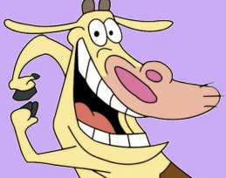

Linear Classification
How to separate cows from chickens?
Size
?
Weight
Blue - Chicks
Red - Cows

Slide 4
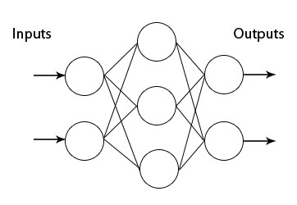
Multi Layer Perceptron
Additional layers gives a possibility to fit any data distribution
Let see it!

Slide 5
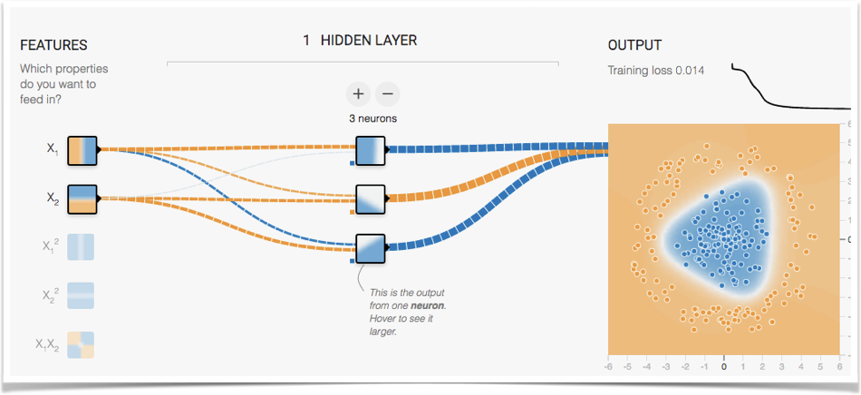

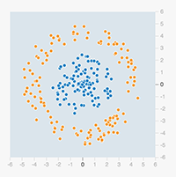
Data Manifolds
More neurons, more features to extract.

Slide 6
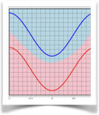

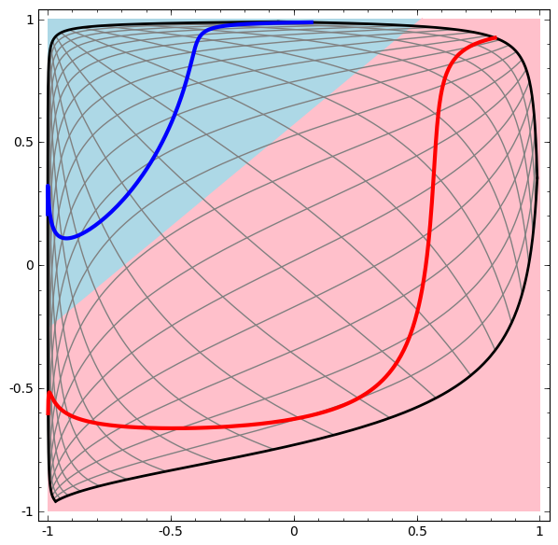
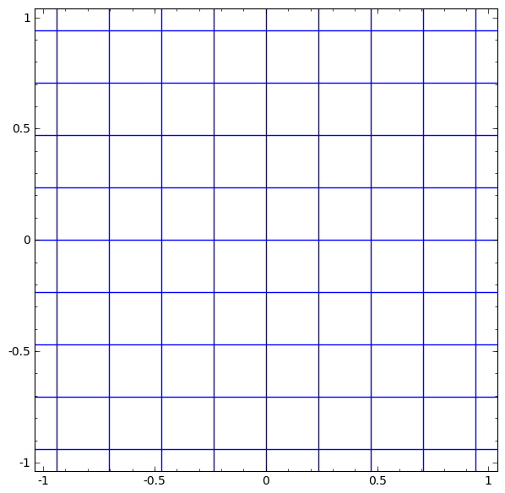
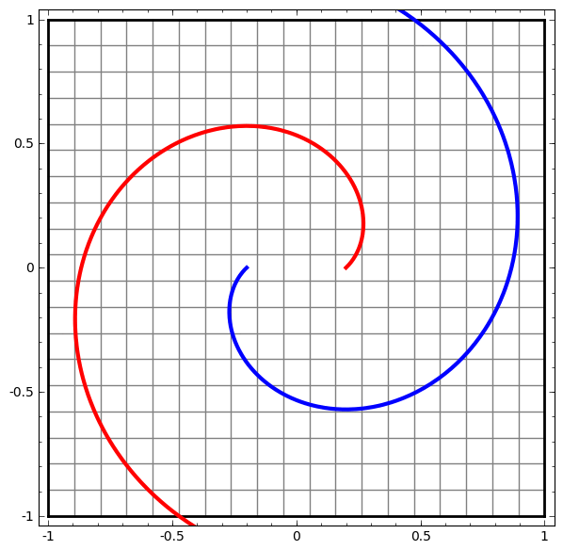
Topology
It is affine transformation
As rubber plane deformations
http://cs.stanford.edu/people/karpathy/convnetjs//demo/classify2d.html
Complex Data example
or

Slide 7
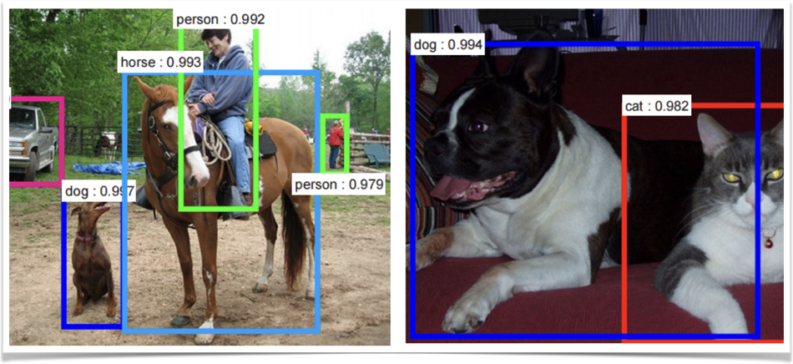
How do they see?
Convolutional Neural Networks

Slide 8
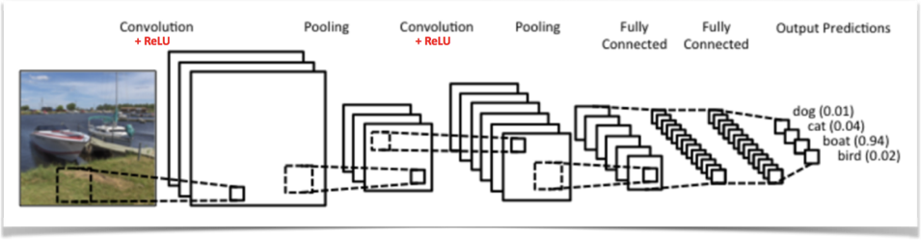

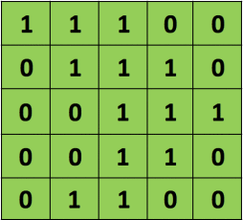

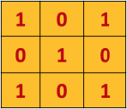
ConvNets derive their name from the “convolution” operator. The primary purpose of Convolution in case of a ConvNet is to extract features from the input image. Convolution preserves the spatial relationship between pixels by learning image features using small squares of input data.
Essentially, every image can be represented as a matrix of pixel values.
Image matrix
Convolution Matrix
Convolution Process

Slide 9
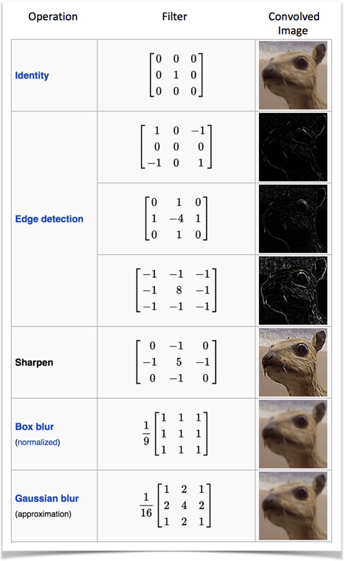

Image Filters.
Examples of Convolution

Slide 10
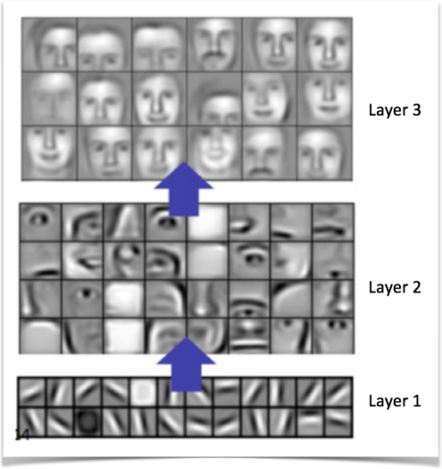
Layers as features
Layers can learn features.
From low level, as strokes
To higher ones, edges, eyes, faces.
Marylin Monroe neuron.

Slide 11

There is no square here!

Slide 12
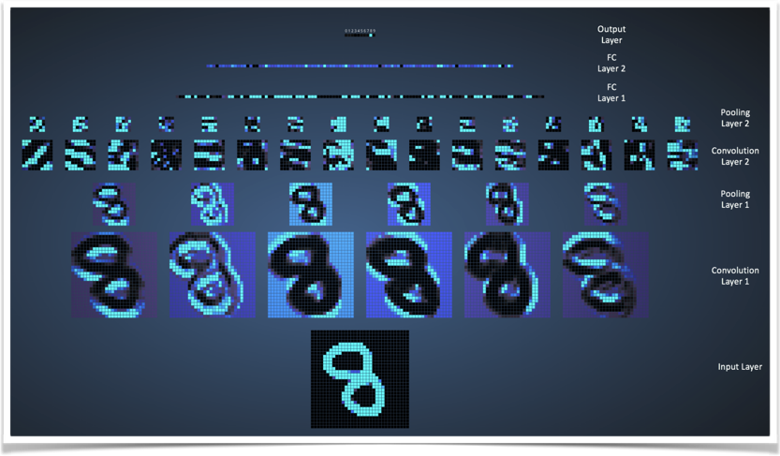
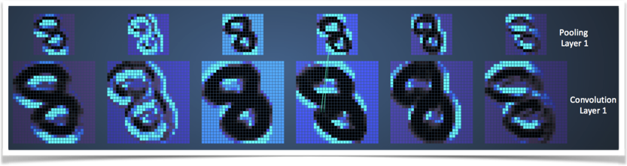

Slide 13
Live examples.
http://scs.ryerson.ca/~aharley/vis/conv/
https://experiments.withgoogle.com/ai/what-neural-nets-see
Deep Dream and Tensor Flow
http://cs.stanford.edu/people/karpathy/ilsvrc/

Slide 14


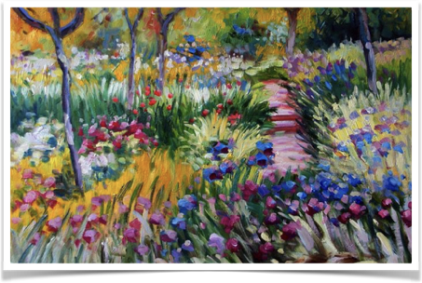

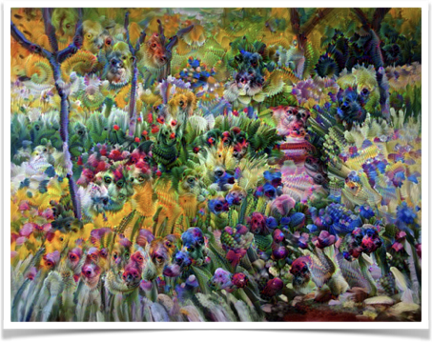
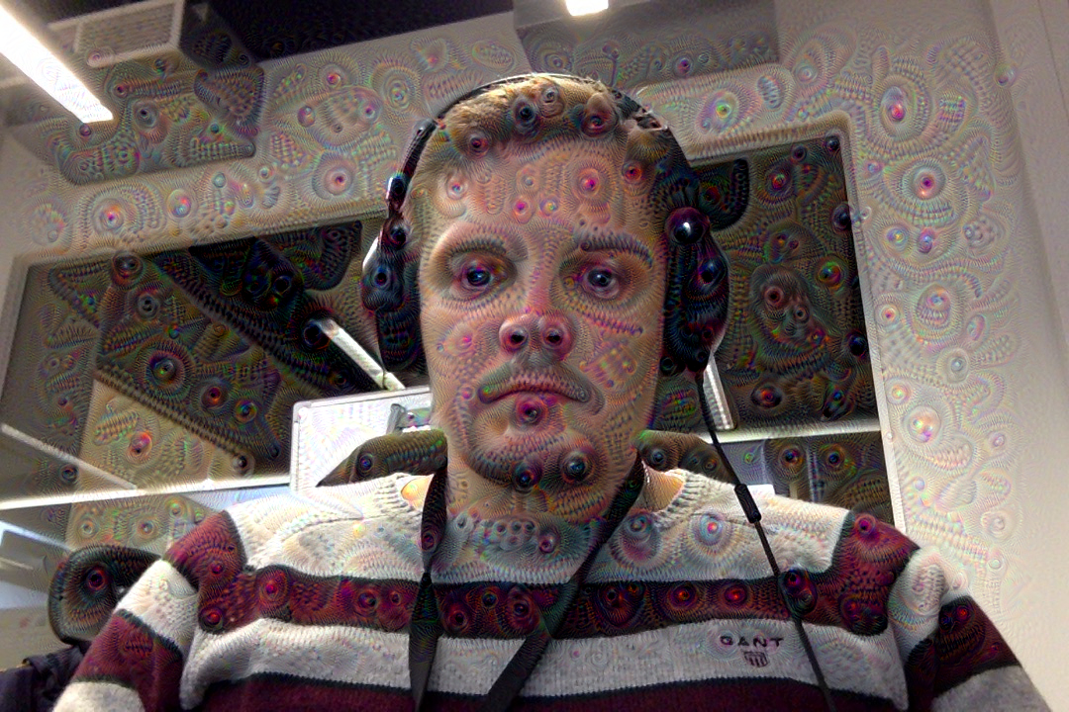

Slide 15
The oft-cited resemblance of the imagery to LSD- and psilocybin-induced hallucinations is suggestive of a functional resemblance between artificial neural networks and particular layers of the visual cortex.

Slide 16
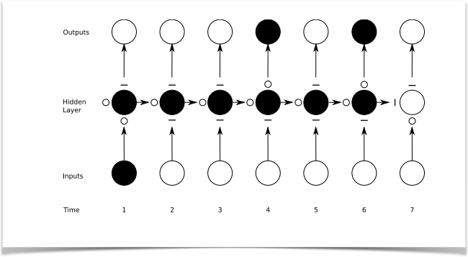
Recurrent
Neural Nets
Adding temporary structure

Slide 17
Recurrent Neural Networks
Can learn text as a stream of characters
Can capture music structure
Can store state

Slide 18
Trained on Linux Source code
static int indicate_policy(void)
{
int error;
if (fd == MARN_EPT) {
/*
* The kernel blank will coeld it to userspace.
*/
if (ss->segment < mem_total)
unblock_graph_and_set_blocked();
else
ret = 1;
goto bail;
}
segaddr = in_SB(in.addr);
selector = seg / 16;
setup_works = true;
for (i = 0; i < blocks; i++) {
seq = buf[i++];
bpf = bd->bd.next + i * search;
if (fd) {
current = blocked;
}
}
rw->name = "Getjbbregs";
bprm_self_clearl(&iv->version);
regs->new = blocks[(BPF_STATS << info->historidac)] | PFMR_CLOBATHINC_SECONDS << 12;
return segtable;
}

Slide 19
Wikipedia XMLs
<page>
<title>Antichrist</title>
<id>865</id>
<revision>
<id>15900676</id>
<timestamp>2002-08-03T18:14:12Z</timestamp>
<contributor>
<username>Paris</username>
<id>23</id>
</contributor>
<minor />
<comment>Automated conversion</comment>
<text xml:space="preserve">#REDIRECT [[Christianity]]</text>
</revision>
</page>

Slide 20
Some music as well
https://deepjazz.io/
https://soundcloud.com/kchoi-research/sets/lstmetallica-drums

Slide 21
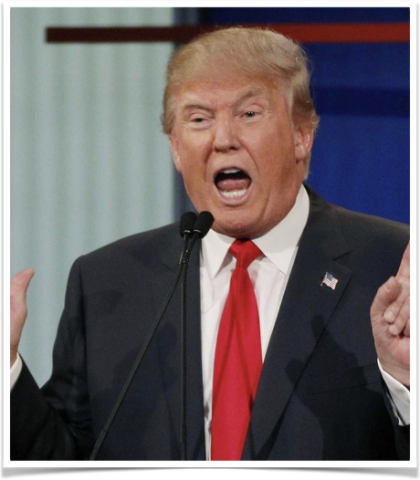
Trump’s Speech generator
Trained on Trump election speeches from June 2016 to November 2016.

Slide 22
What is going on underway.
At the beginning model does not know anything about text and language structure
----- Sample 1 -----
Lеfs mint alo she g tor, torink.han, aulb bollg rurr Atans ir'd ciI anlot, ade dos rhant eot taoscare werang he ca m hltayeu.,hare they Woy theaplir horet
iul pe neaf it Yf therg. hhat anoy souk, thau do y RO Bury f
if. haveyhaled Dhorlsy Ato thinanse rank fourile DaniOn Ttovele yhinl ans anu he B
it is starting to get an idea about words separated by spaces. And got some knowledge about some simple words.
----- Sample 2 -----
aly Eo, He, to bakk st I stire I'micgobbsh brond thet we sthe mikadionee bans. Whether job lyok,.
Whon not I ouuk.
Wewer they sas I dait ond we polntryoiggsiof, waoe have ithale. I bale bockuyte seemer I dant you I Fout whey
We kuow Soush Wharay nestibigiof, You knik is you know, boxw staretho bad
I, not, job, - some of the learned words, it looks like some text.
----- Sample 3 -----
cy doing to whit stoll.
Ho just to deed to was very minioned, now, Fome is a soild say and is is soudd and If no want nonkouahvion. if you beeming thet take is our tough us iss could feor youlk to at Lend and we do toted to start to pasted to doind the we do it.
I jind and I spongly stection Caread.
Looks more like English

Slide 23
What is going on underway.
Completed 340 minibatches of size 32x1000 characters
----- Sample 4 -----
Second. They left you asses, believe me, but I will have great people.I solling us some -- and you see something youve seen deterner to Mexico, we are building interest.
100,000. Im not going to be so bad.
It was so proud of me. Incredible and or their cities which I kept the same wealthy. They dont want them, were the world companies.
Yes, they get the fraud, except people deals 100. Its like never respaved us. Thats what were going to do an orfone thats seen this.
So we’re going to run. But I was going to have all the manufacturing things as you know what we’re not going to be very soon to this country starting a president land the country. It’s the committed to say the greatest state. You know, I like Iran is so badly. I said, "I’m not as you know what? Why aren’t doing my sad by having any of the place so well, you look at 78%, I’ve done and they’re coming in the Hispanics are so many. The different state and then I mean, it’s not going to be these people that are politicians that they said, "You know, every poll said "We will bring it. I think we don’t want to talk about the stupid new of this country. We love it of money. It’s running the cary America great.
Let see some output……

Slide 24
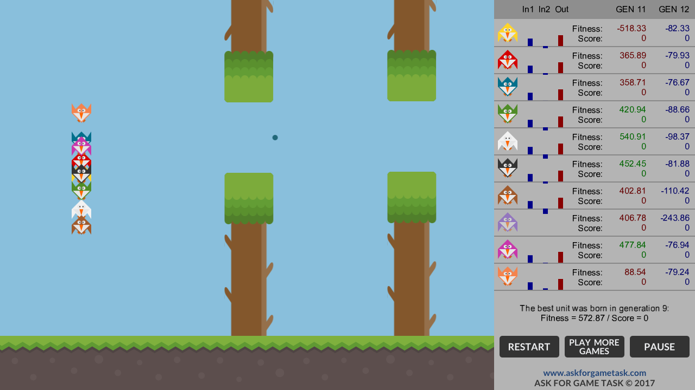
Reinforcement Learning
Flappy Bird Evolution

Slide 25
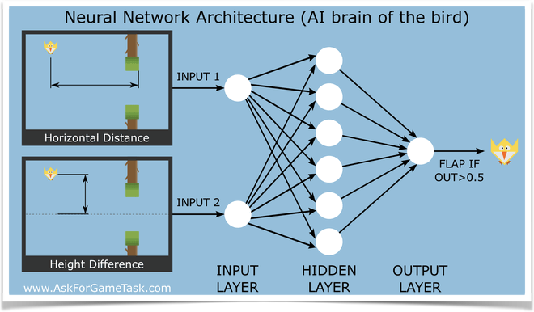
Neural Model of a Bird
How to learn to fly using genetic algorithm
Best live longer

Slide 26

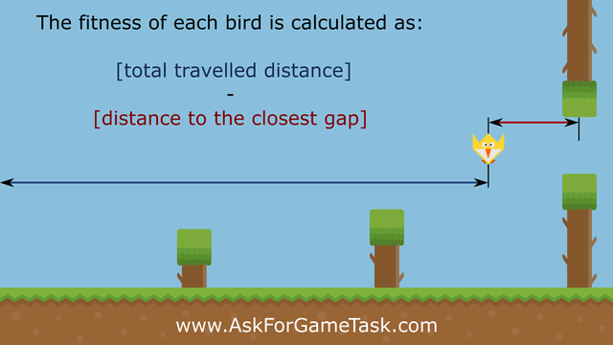
Select best fitness
Evolution of best models
add mutations

Slide 27
https://www.youtube.com/watch?time_continue=128&v=aeWmdojEJf0
http://www.askforgametask.com/html5/tutorials/flappy/

Slide 28
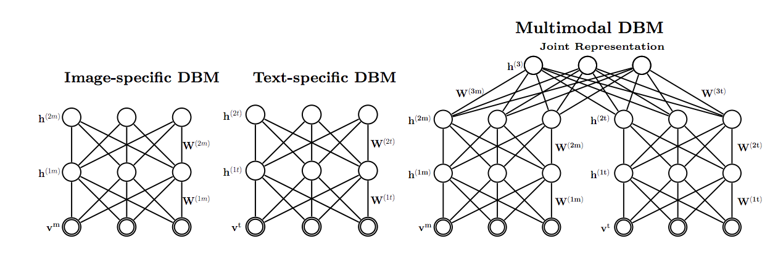
Multimodal Learning
http://jmlr.org/papers/volume15/srivastava14b/srivastava14b.pdf

Slide 29
Questions?

